Slide 1
Re-analysis of Variant Effect Maps
BCB330 Final Presentation
Bilin Nong
Supervisors: Jochen Weile & Fritz Roth
@ the Roth Lab

Slide 2
Outlines
Introduction
MAVEs: a proactive approach
New pipelines vs. Old pipelines
Objectives
Reprocess raw data
Evaluation
Results
SUMO1
CALM1

Slide 3
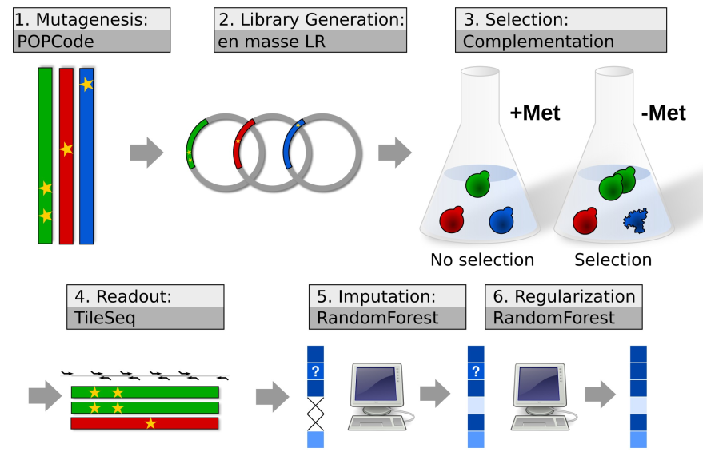
Multiplex Assays of Variant Effect (MAVEs)
Thank Jochen for making the graph!
Notes:
POPCode Mutagenesis -> codon randomized variant libraries
Subsequently, transfer the entry libraries to expression vector to enable expression
Then, we assays – select the cells that have functional copies of protein
Tileseq/barseq strategy can be used for reading out the effects of selection
Imputation/ regularization can be use downstream computational analysis

Slide 4
New & Old version of MAVEs pipelines
Old – collapsing equivalent codon changes → calculate the score from combined amino acid changes & filtering
New – calculate score on codon changes separately → filtering → merge
Sacrifice Power for accuracy, but may have more noise potentially

Slide 5
Objectives
1. Re-process the raw data underlying existing variant effect maps with the latest versions of analysis pipelines.
2. Evaluate the performance of different versions of MAVE pipelines.

Slide 6
Outlines
Introduction
MAVEs: a proactive approach
New pipelines vs. Old pipelines
Objectives
Reprocess raw data
Evaluation
Results
SUMO1
CALM1

Slide 7
SUMO1
QC Results
Correlation between New Scores & Old Scores
Correlation between Fitness Scores & VARITY Scores
Conclusion

Slide 8
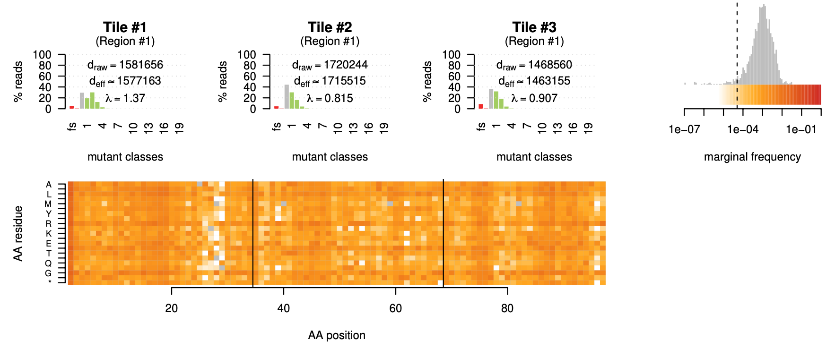
Good Overall Coverage
Filtered out
Possible reason: low efficiency of mutagenesis
Notes:
Low coverage – mutagenesis lower efficiency

Slide 9
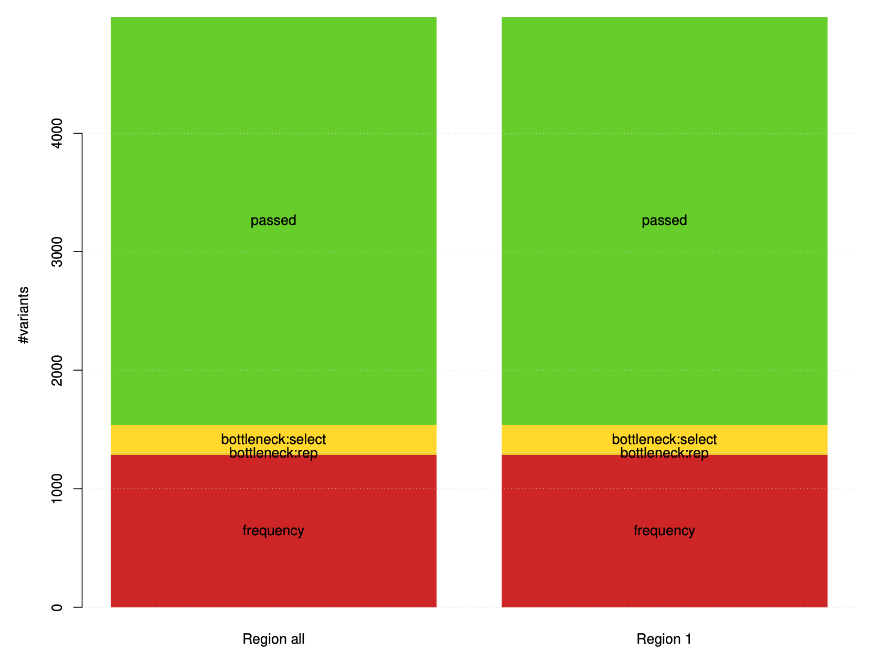
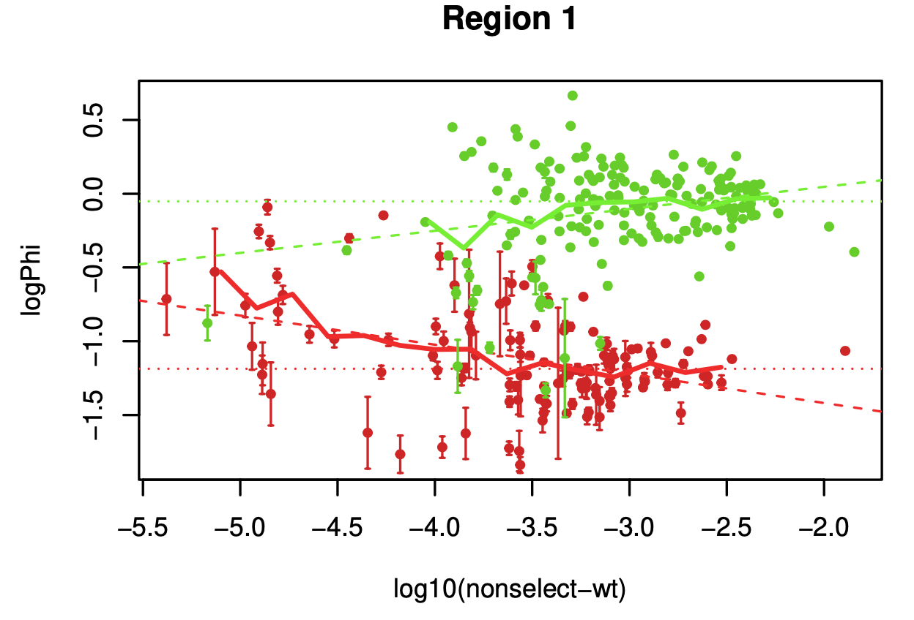
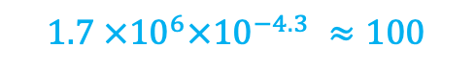
1/3 of SUMO1 variants are subject to Frequency Filter
Sequencing depth
~ -4.3
Minimum read count :
$${1.7 ×10}^{6}×{10}^{−4.3} ≈100$$
Notes:
Good separation
Freq = , -4.3 , line

Slide 10
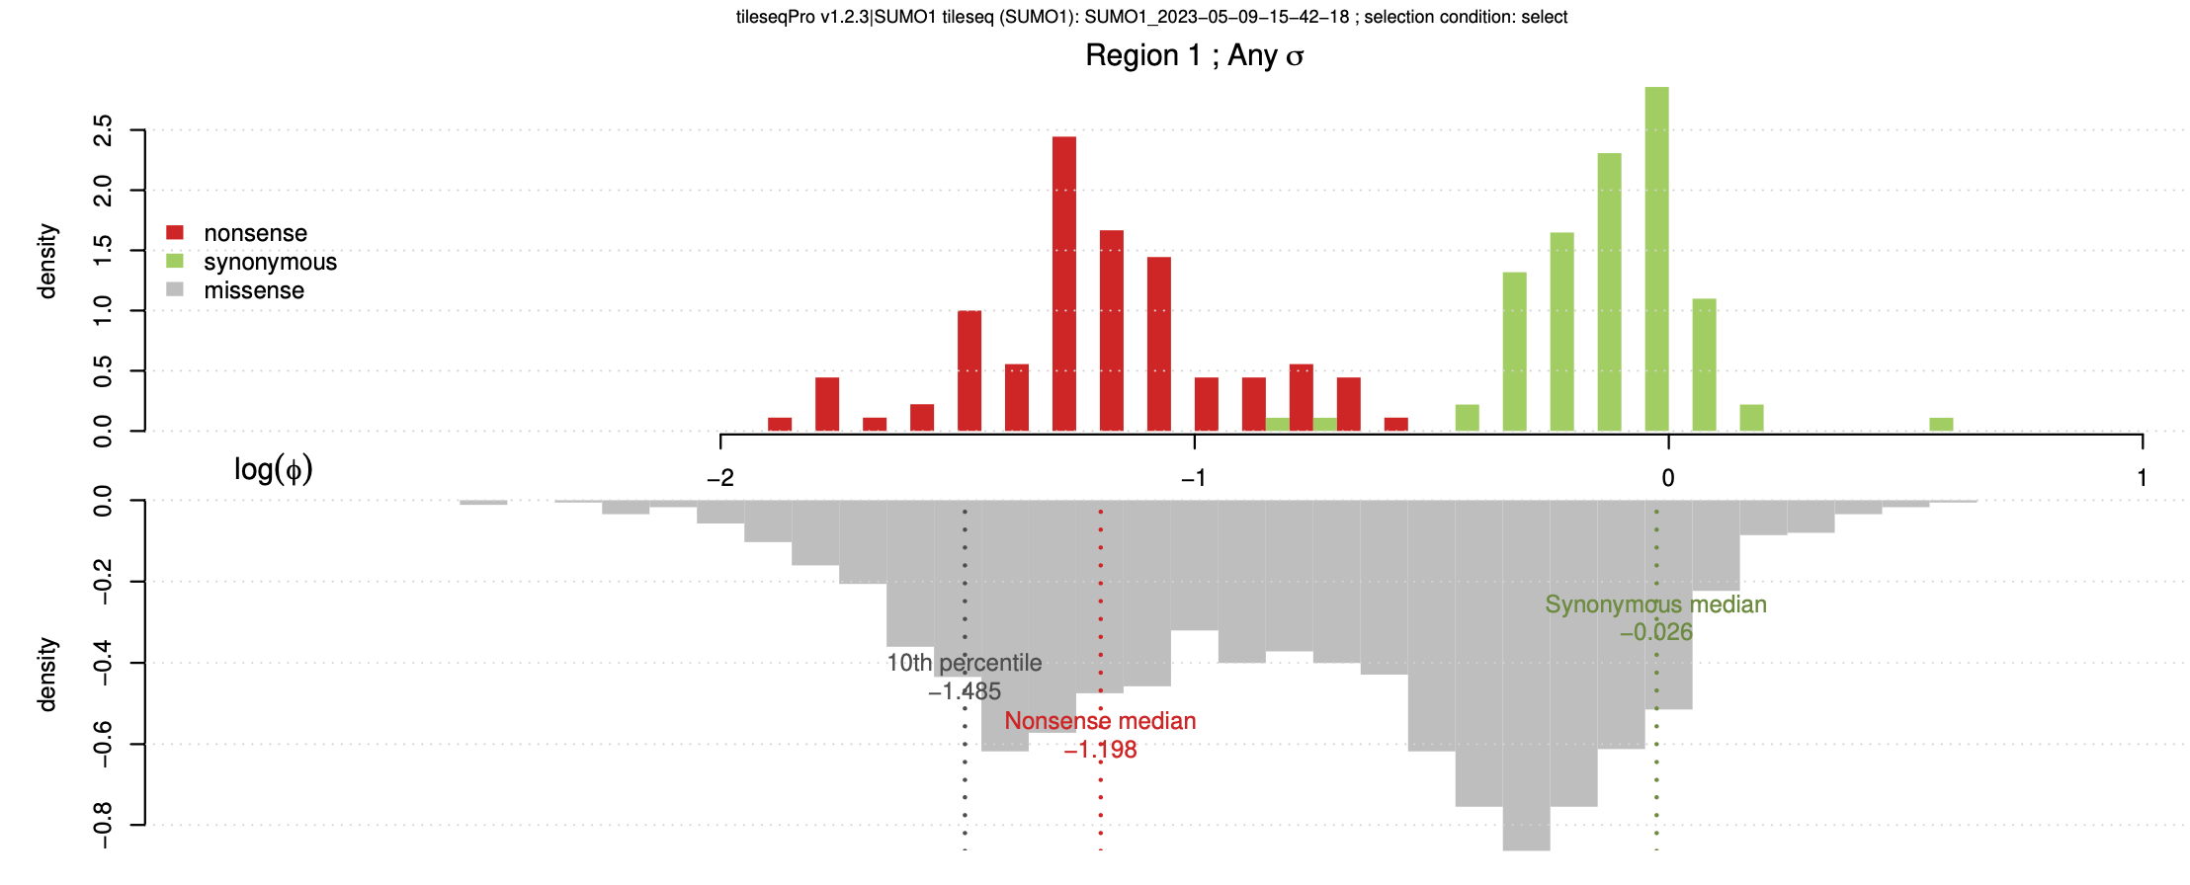
Good separation between nonsense & Synonymous Variants
Reliable selection assays
Nonsense mode has higher enrichment values than the missense variants
Filtering Issues/ Measurement Error
Notes:
Filtering issue, measurement error

Slide 11
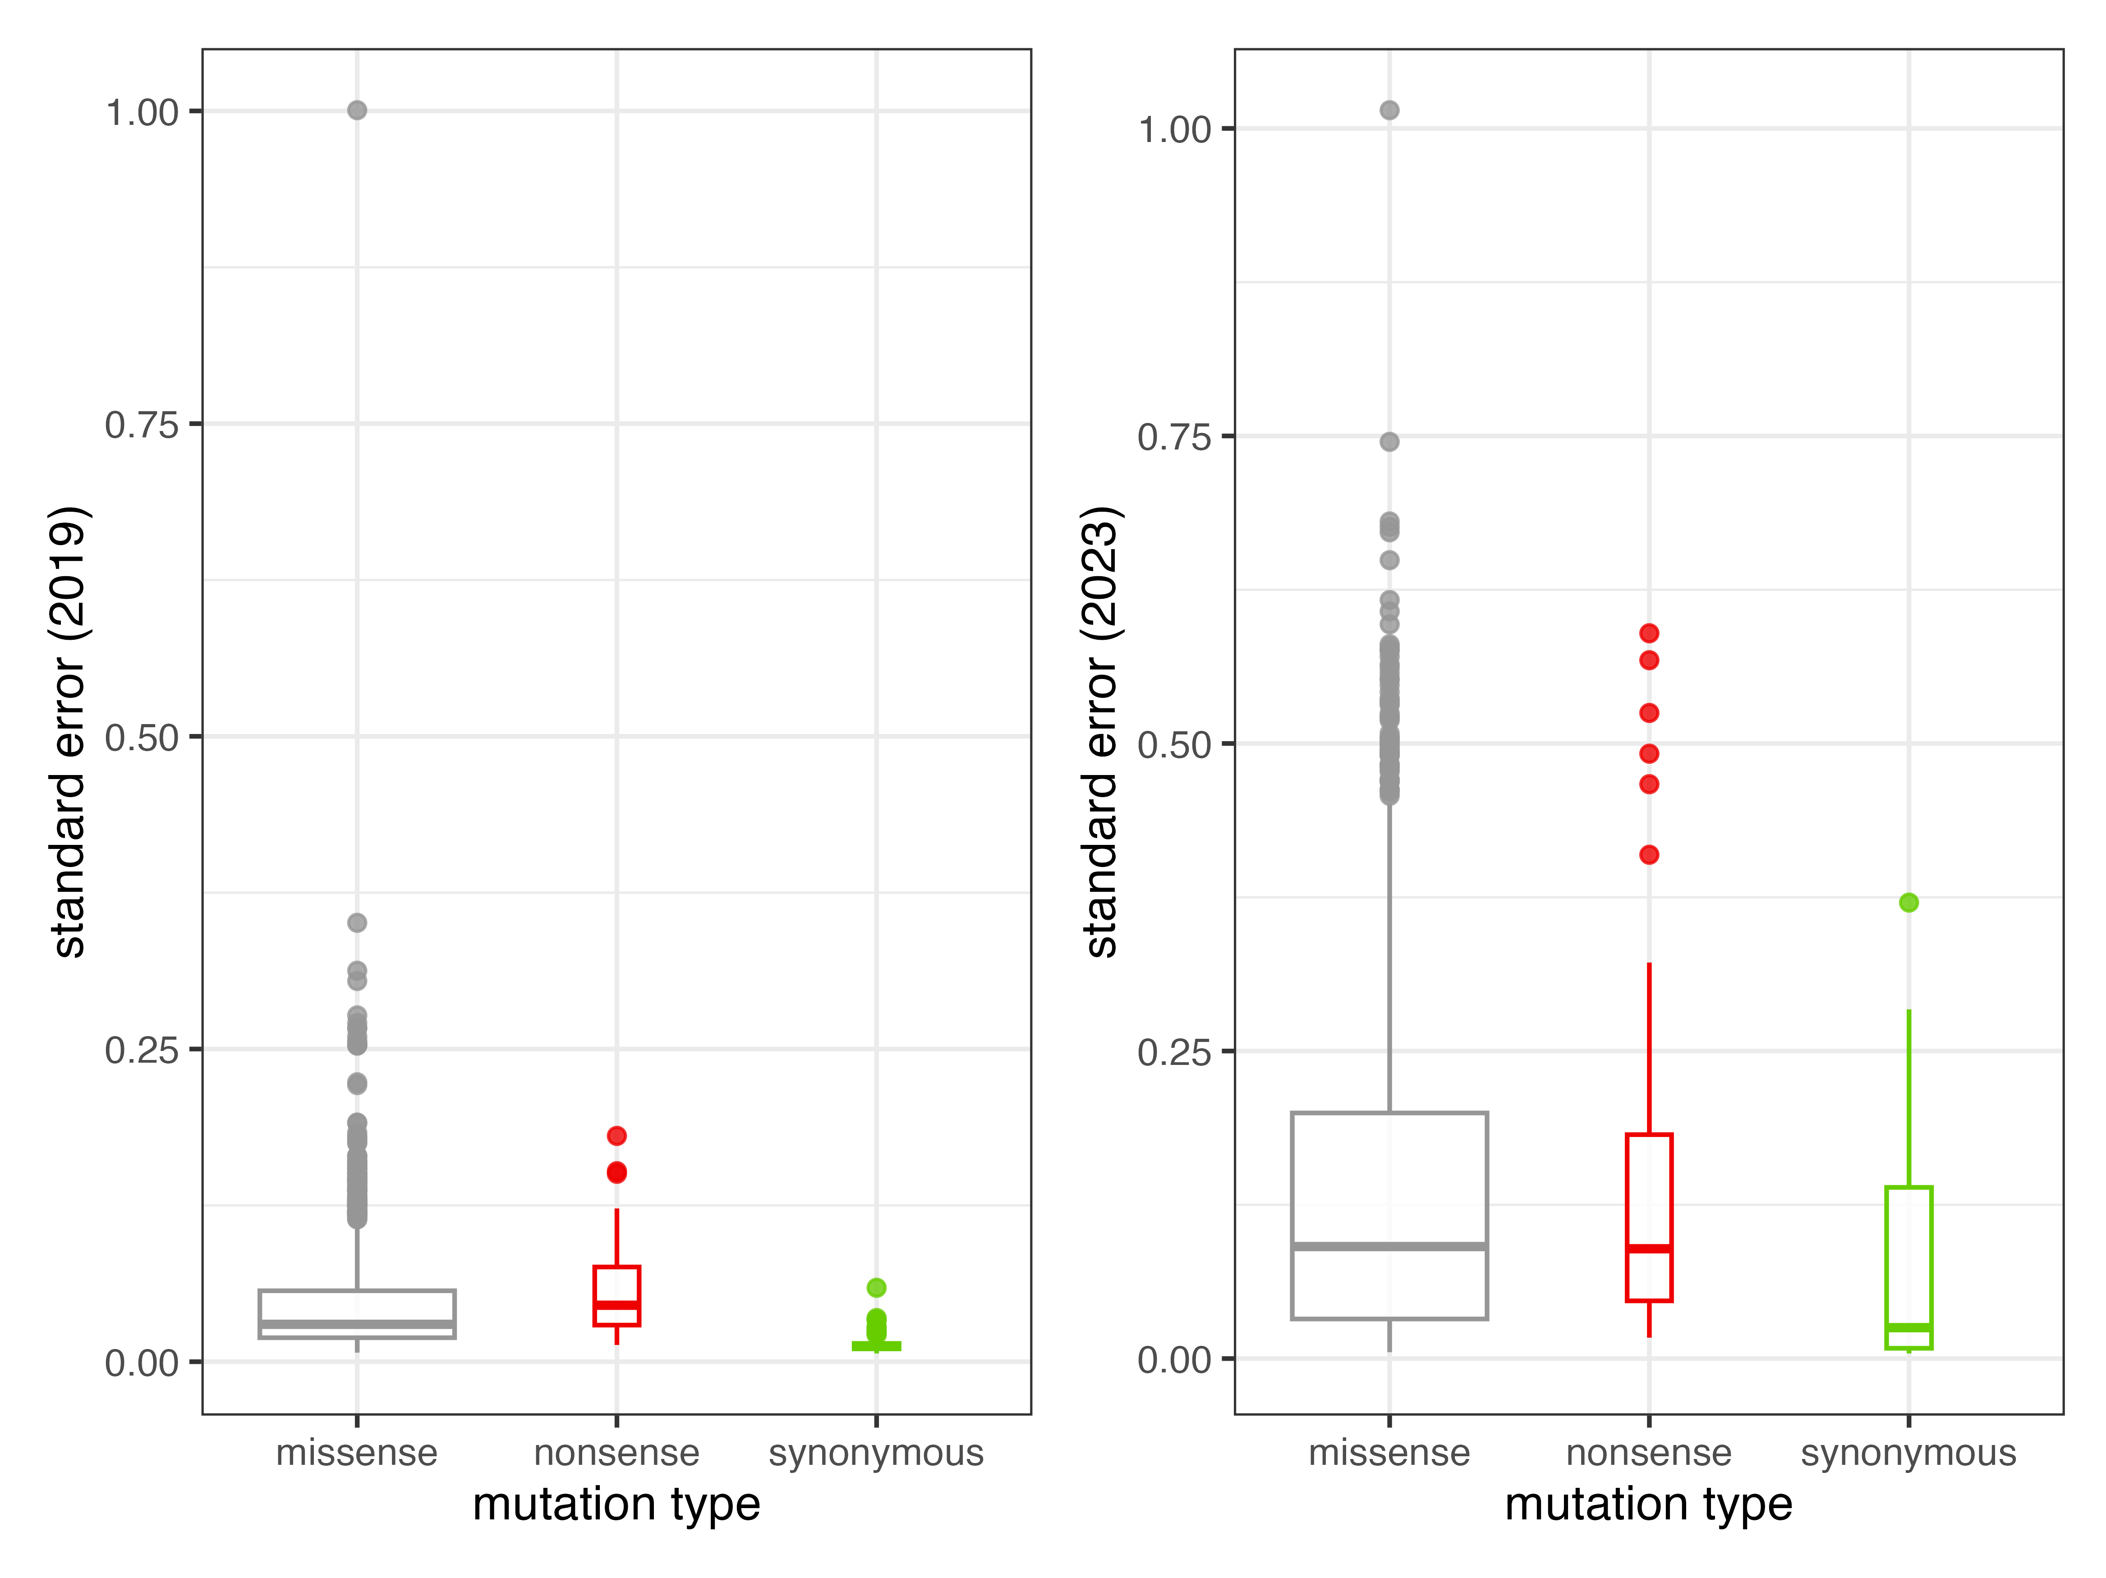
2023 version fitness Scores has higher SE than the Old Scores
Possible Reasons:
Bootstrapping in new pipelines
More accurate & Pessimistic error Regularization
2019
2023
Notes:
Bootstrapping in new – more accurate , more pessimistic error regularization

Slide 12
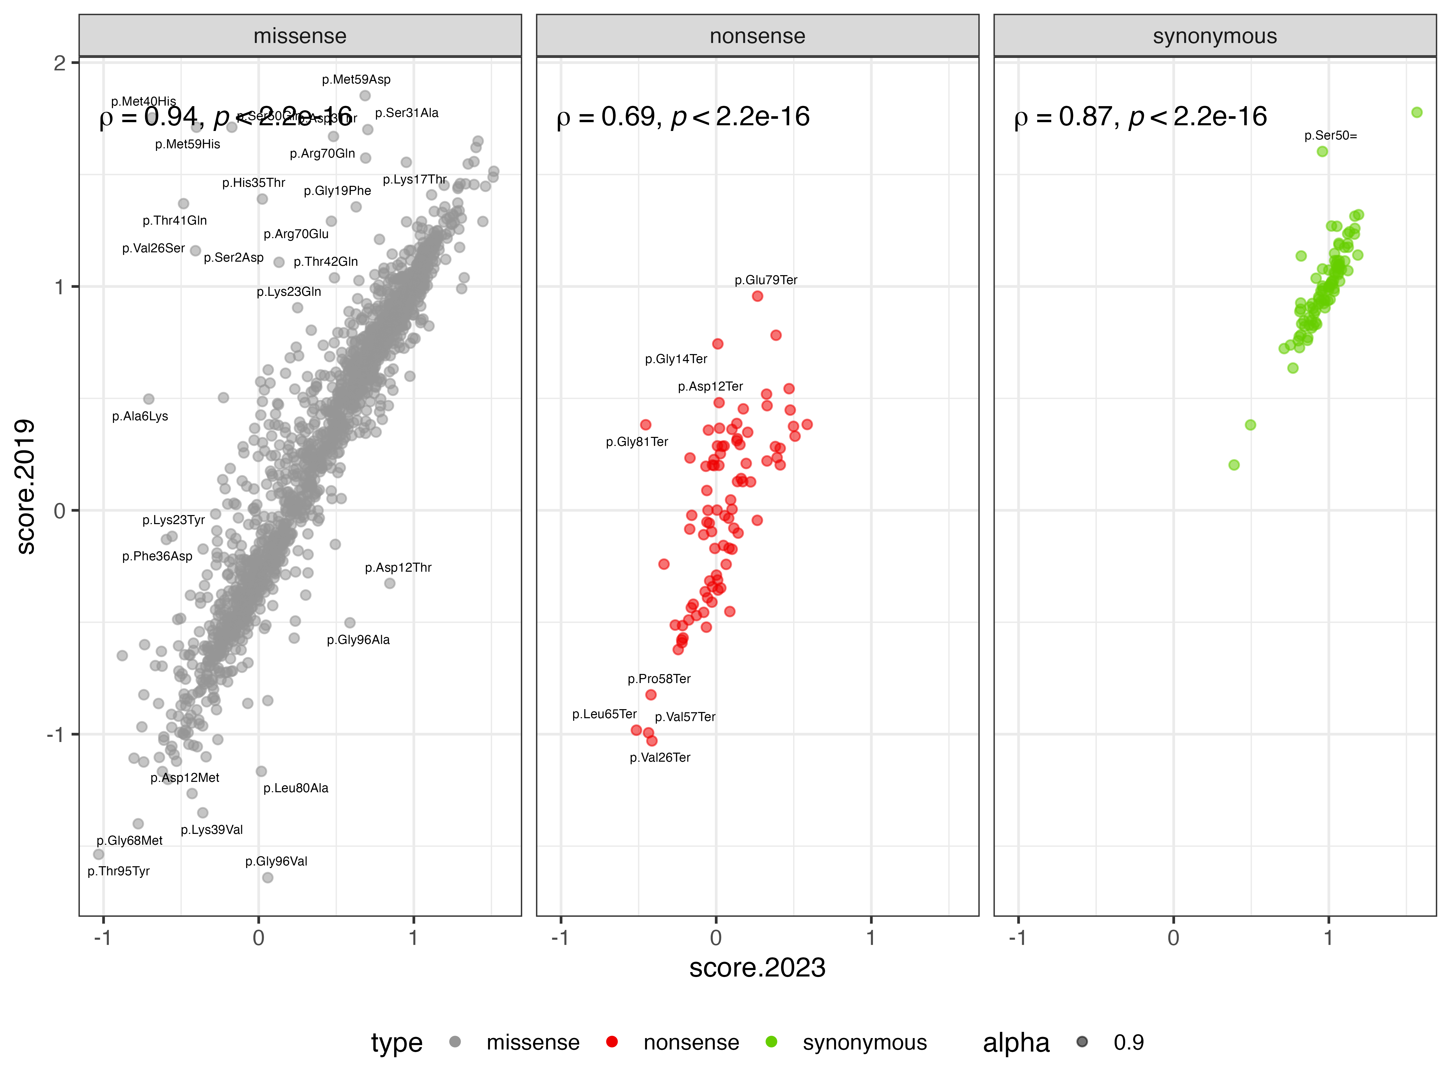
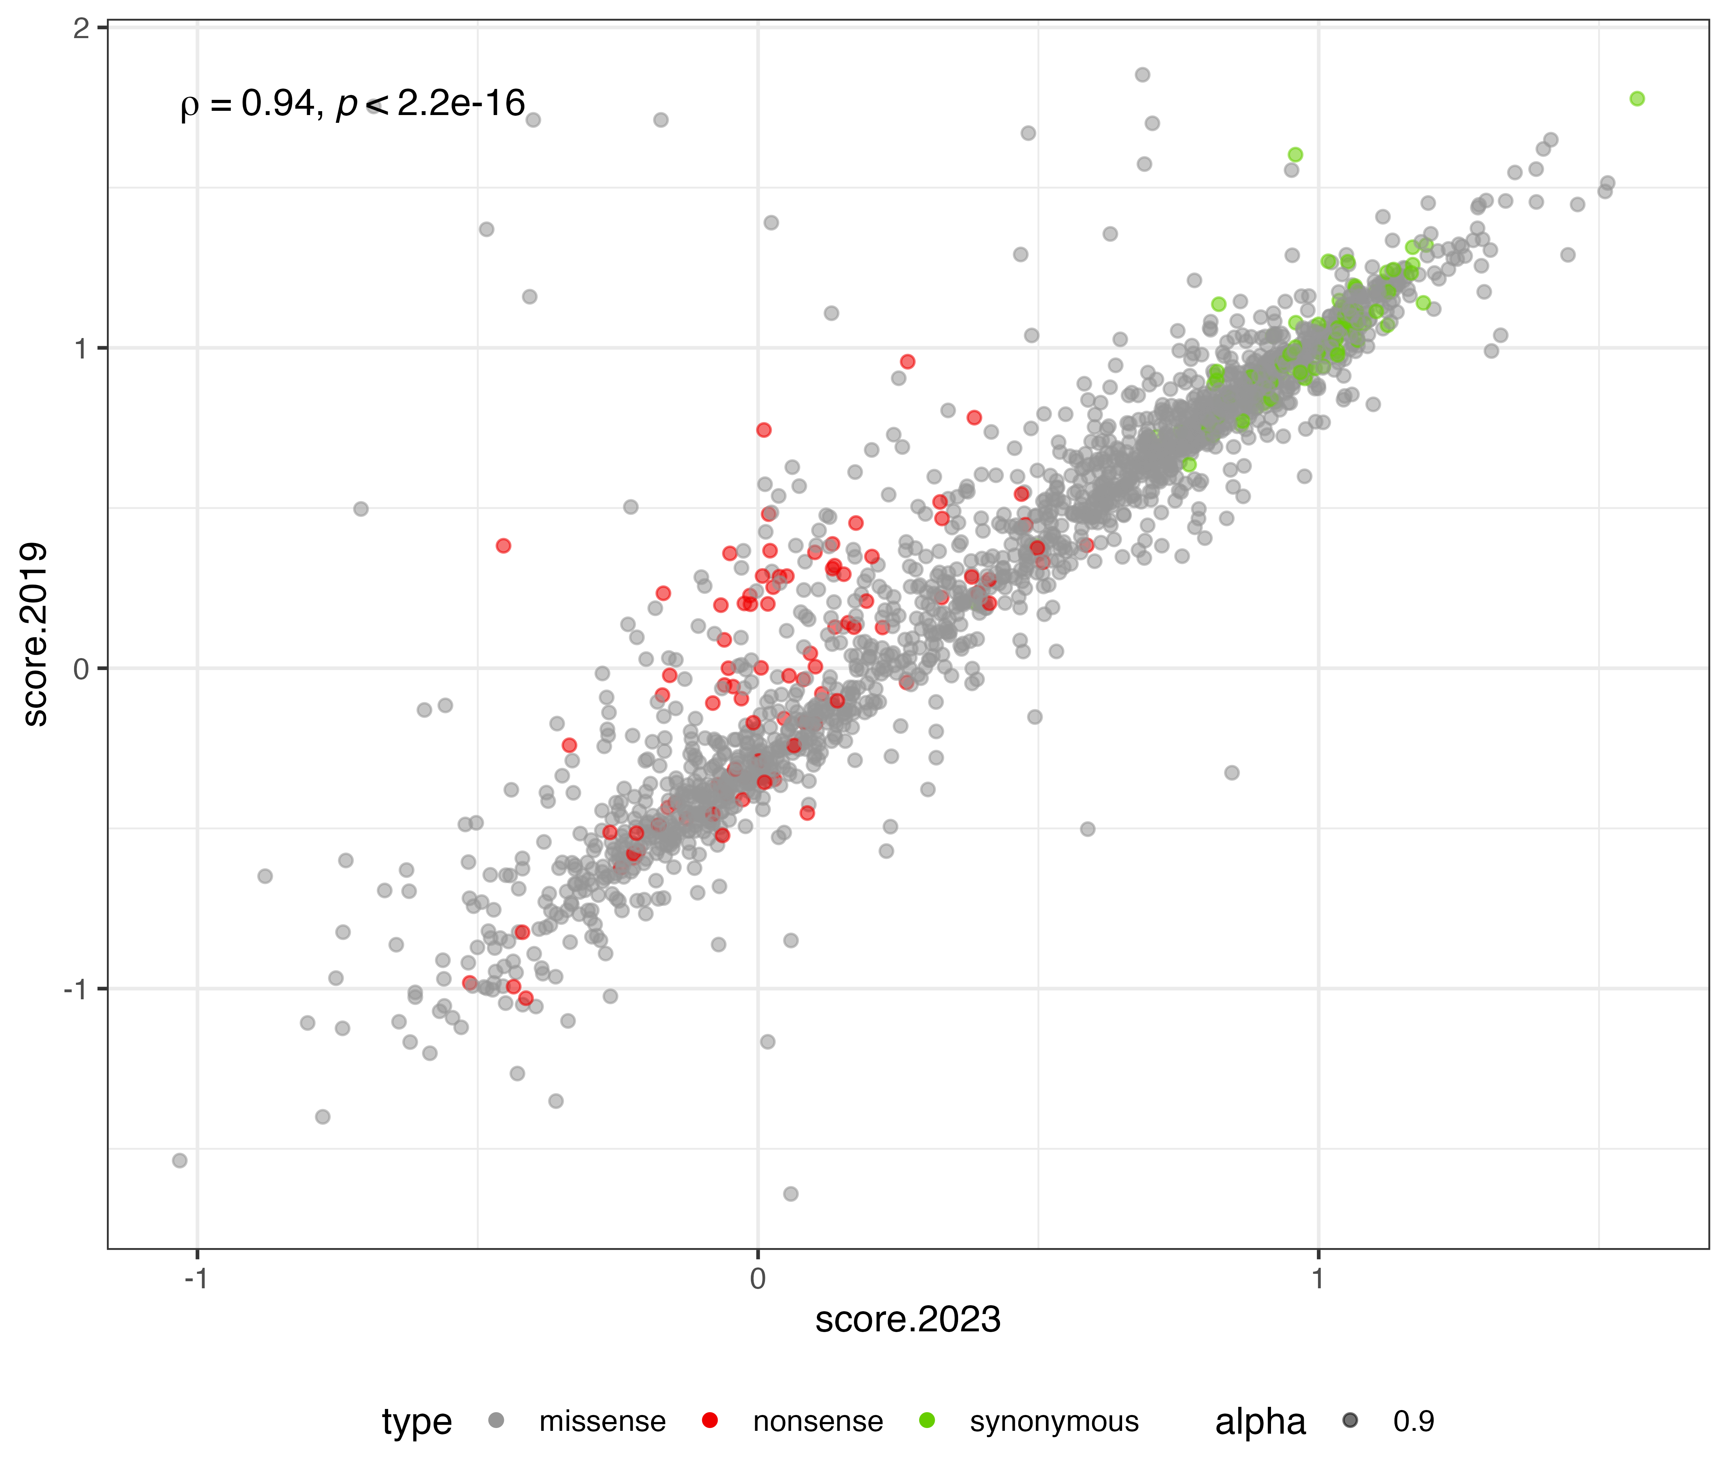
High Correlation between New & Old Scores
Lower correlation for nonsense variants: less information
Notes:
Less correlation for nonsense – higher se
Few codon changes -- filter out , less information

Slide 13
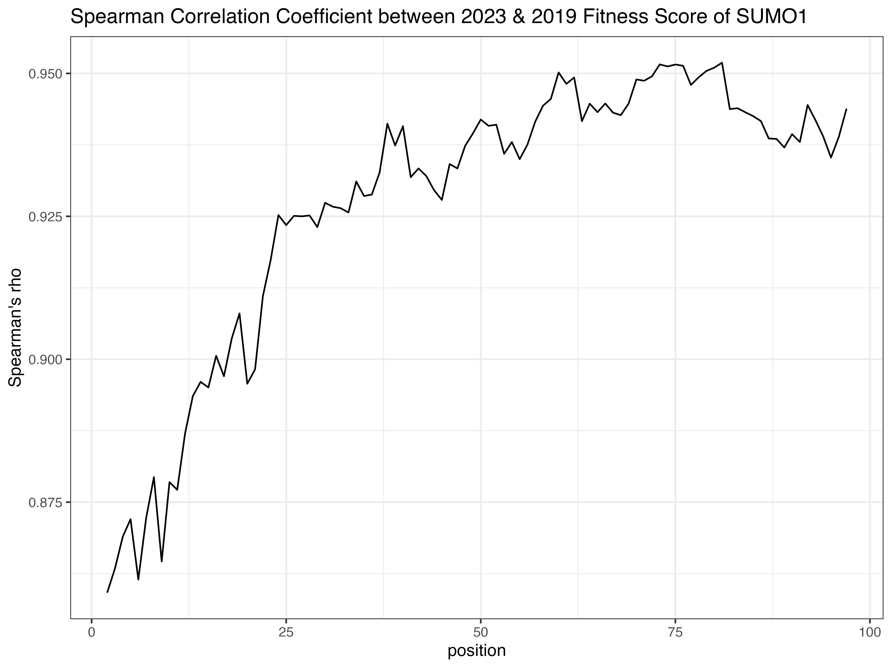
Disorder Region of SUMO1 (synonymous like)
Notes:
First 20 – disorder , score – high, synonymous like

Slide 14
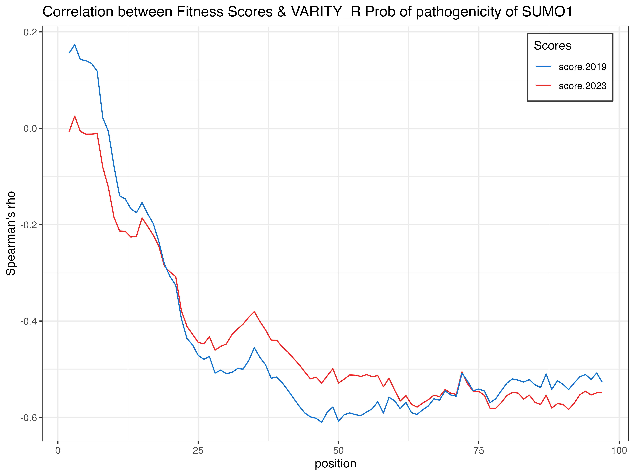
Anti-Correlation between fitness scores and VARITY_R Score
VARITY: produce a probability of pathogenicity (scale oppositely to fitness scores)
Notes:
PRC – not a disease gene, cannot get a reference set

Slide 15
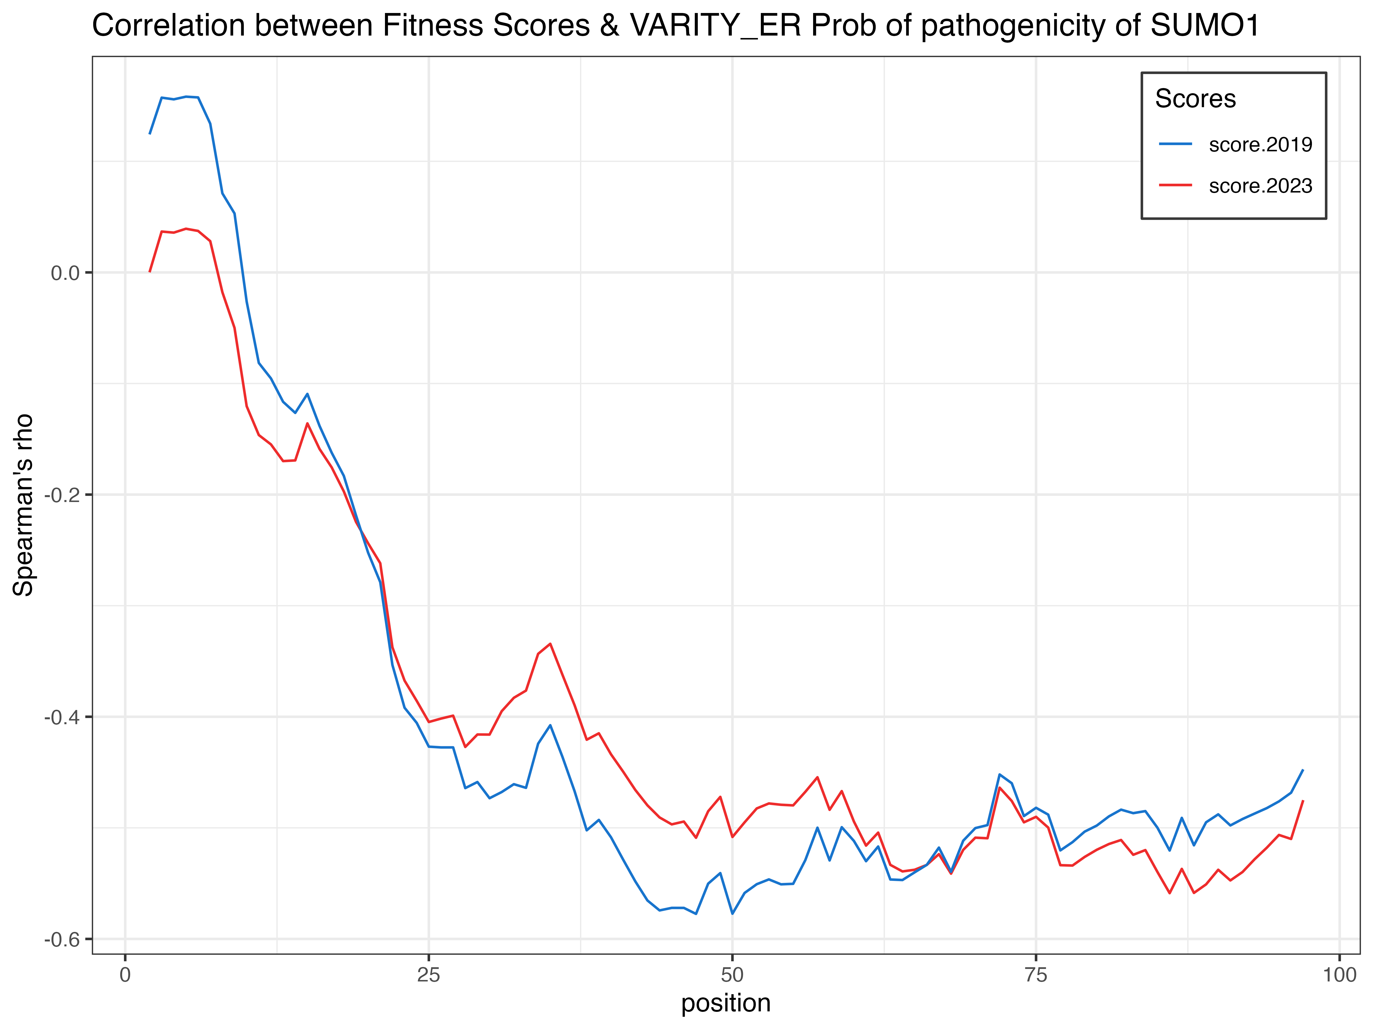
Anti-Correlation between fitness scores and VARITY_ER Score
Notes:
Anti correlation –better

Slide 16
SUMO1: conclusion
The New pipelines & Old pipelines performed similar
The New pipelines used more info on generating the error estimates → Accurate Error Estimation

Slide 17
CALM1
QC Results
Correlation between New Scores & Old Scores
PRC
LLR of Pathogenicity
Conclusion

Slide 18
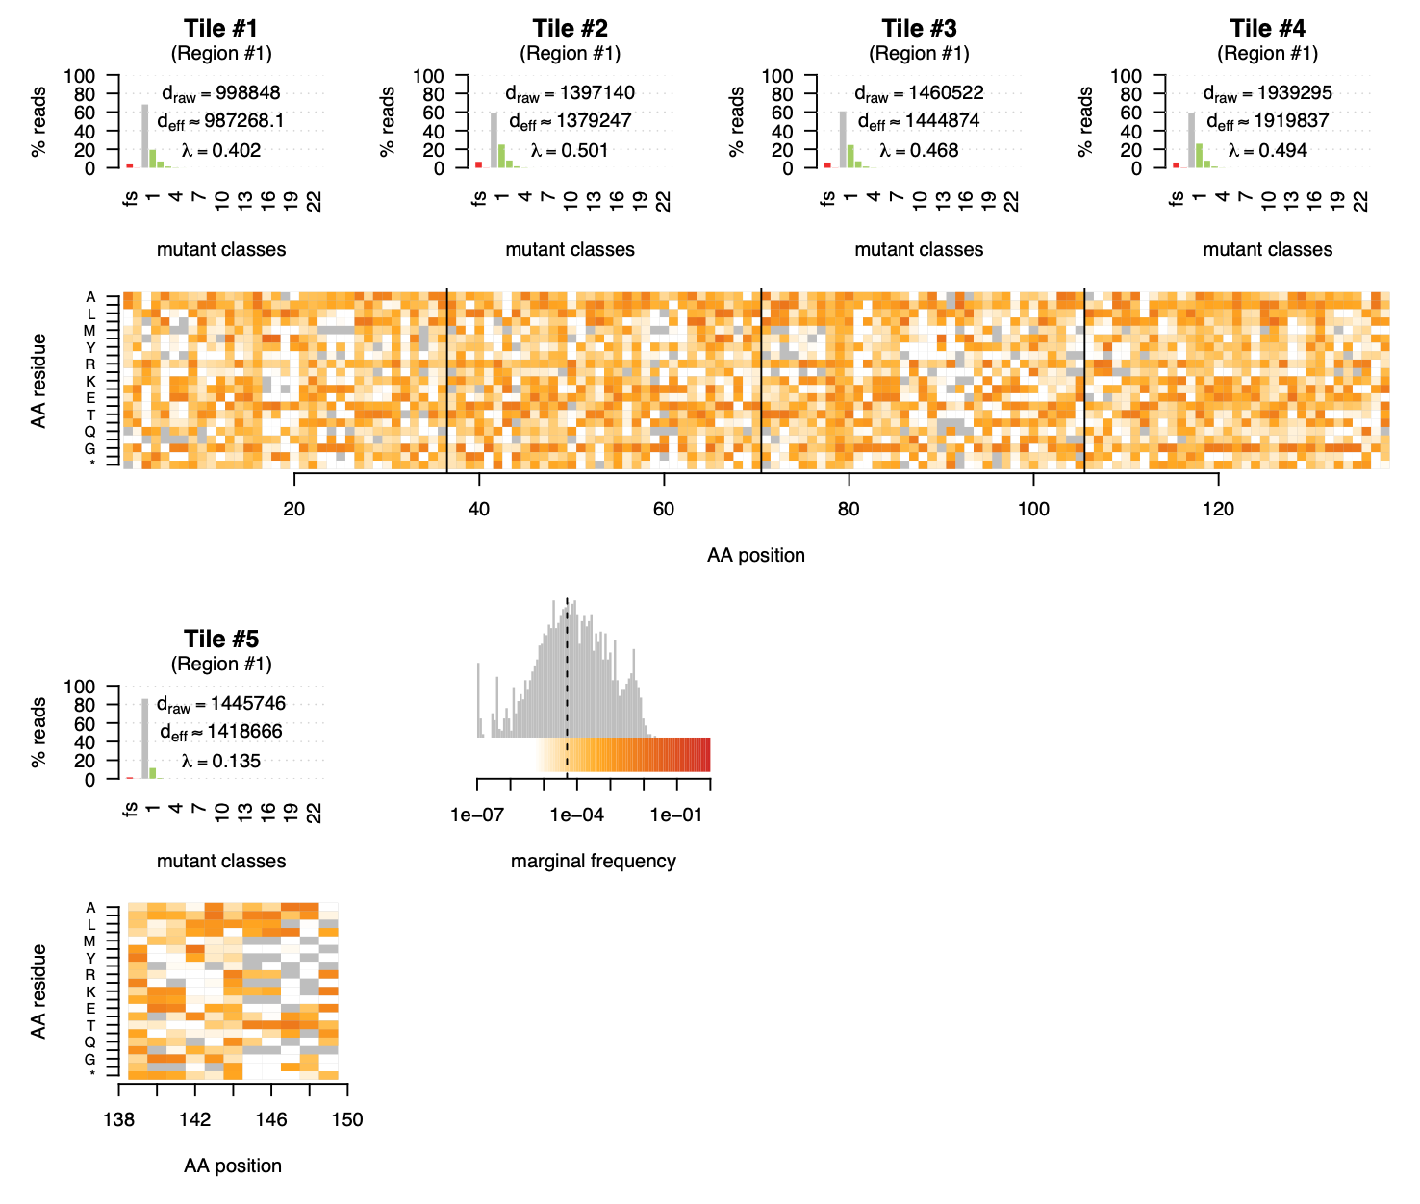
Low Coverage
Filtered out
Possible Reason: Low efficiency of mutagenesis

Slide 19
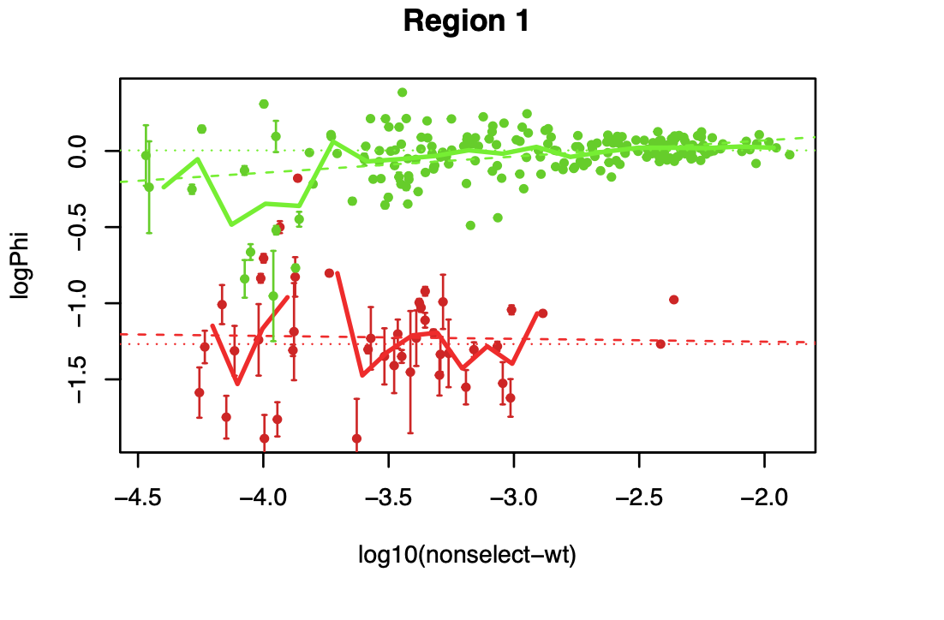
~ 2/3 of Variants were filtered out
~ -4.3
Minimum read count:
$${1.2 ×10}^{6}×{10}^{−4.3} ≈100$$

Slide 20
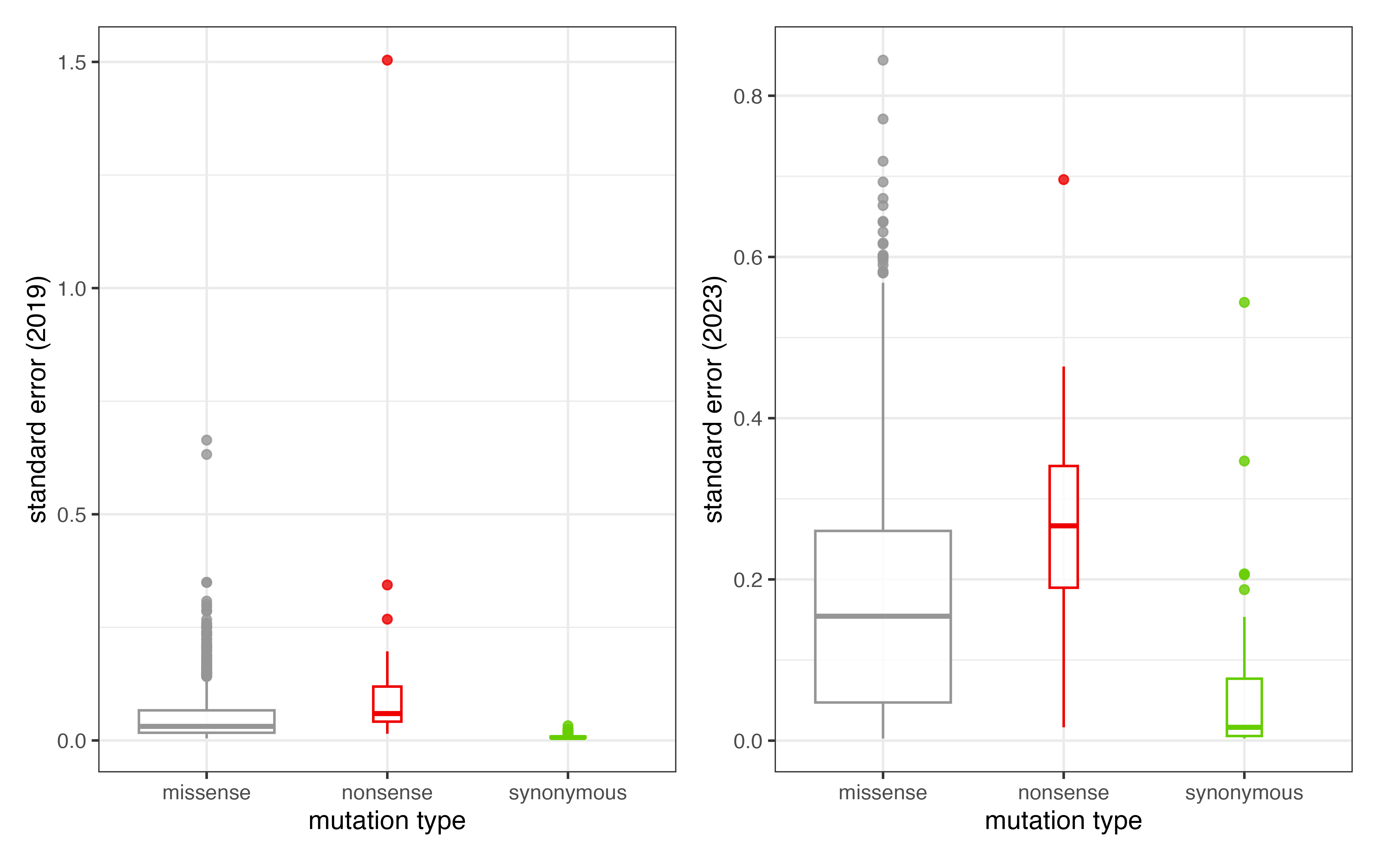
2023 version fitness Scores has higher SE than the Old Scores
2019
2023
Nonsense variants have highest SE

Slide 21
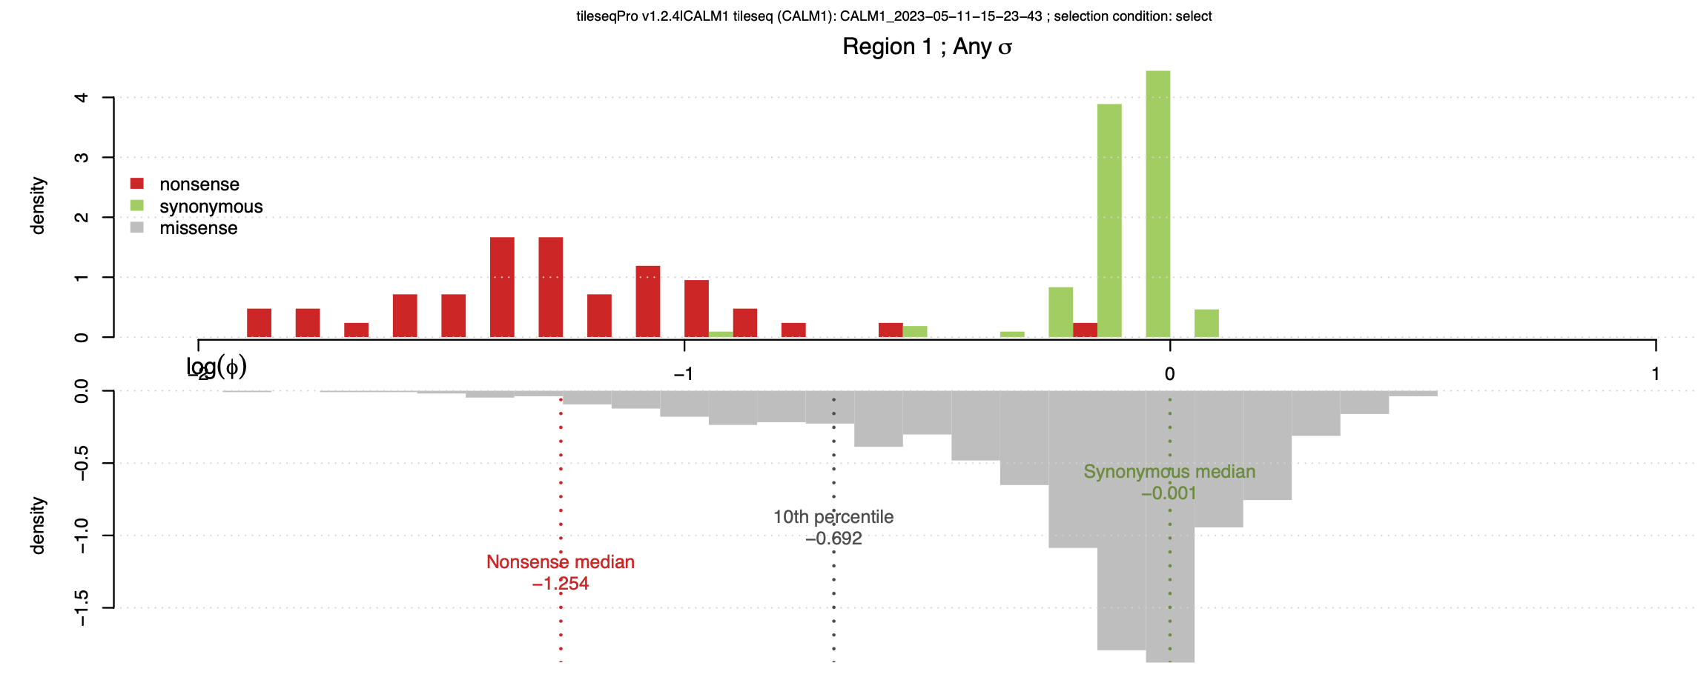
Good separation between the nonsense & synonymous Variants
One mode in missense variants – not so damaging
Notes:
Filter – good separation, one mode in missense (not damaging )

Slide 22
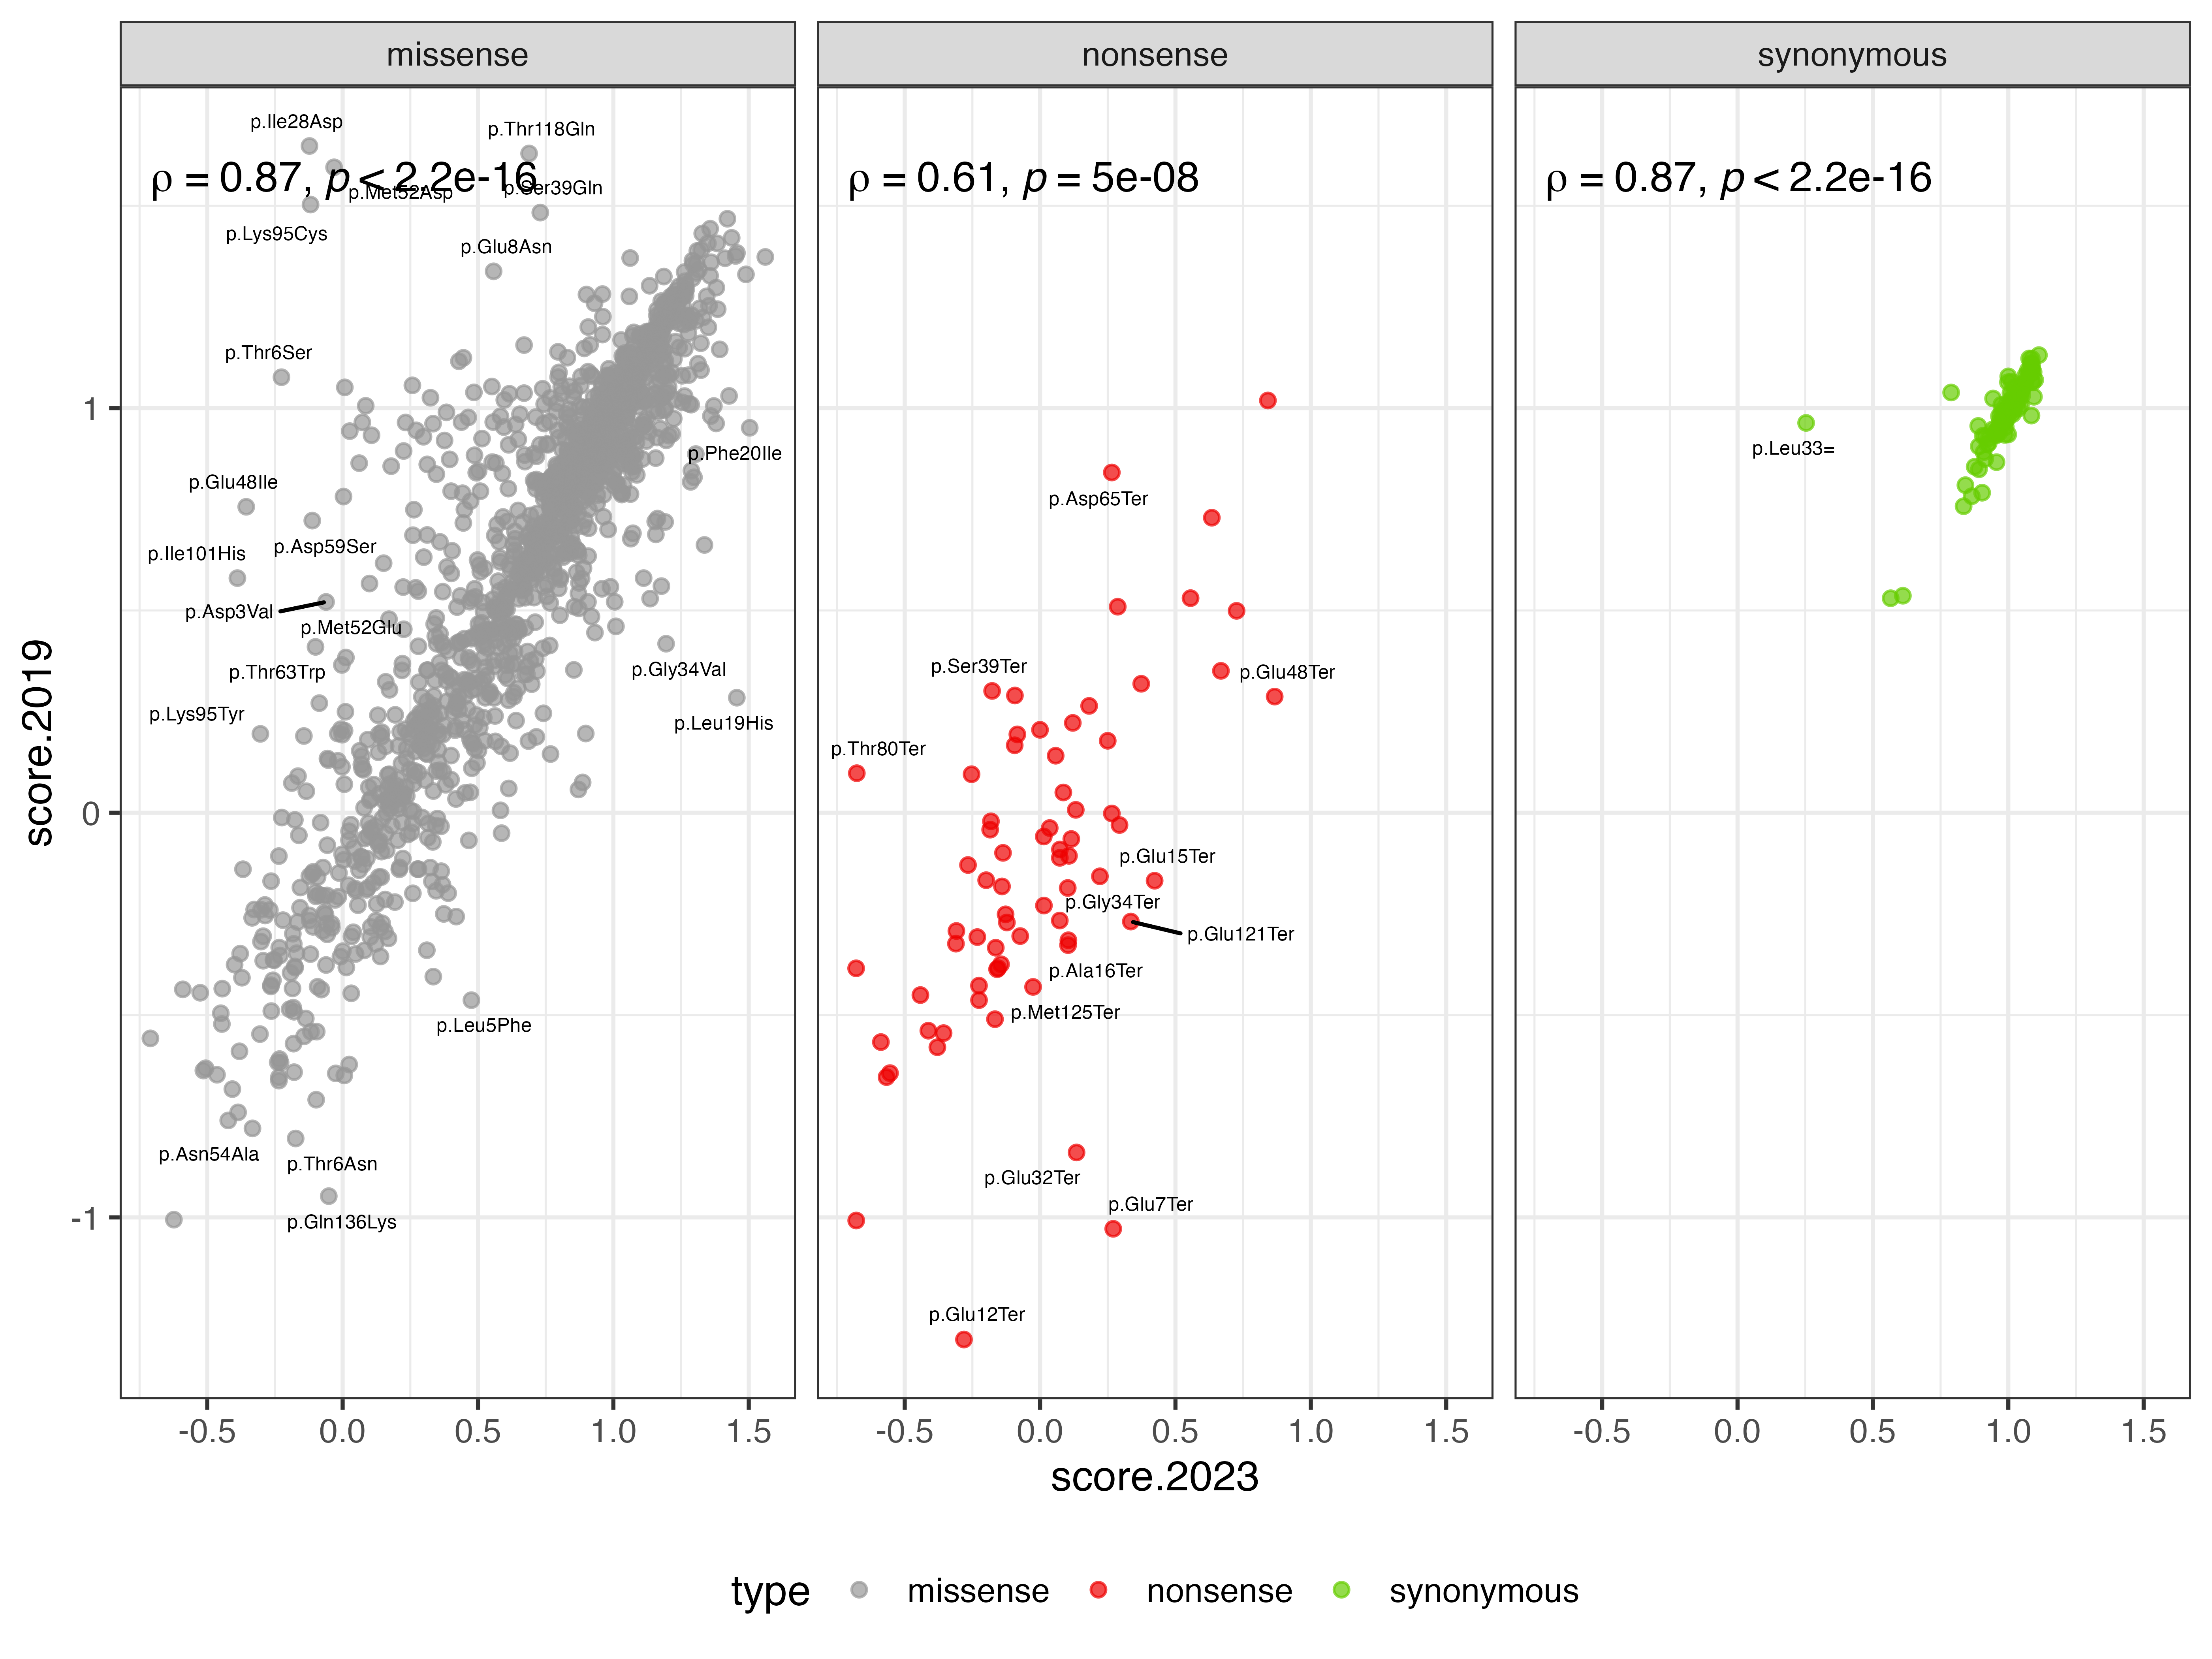
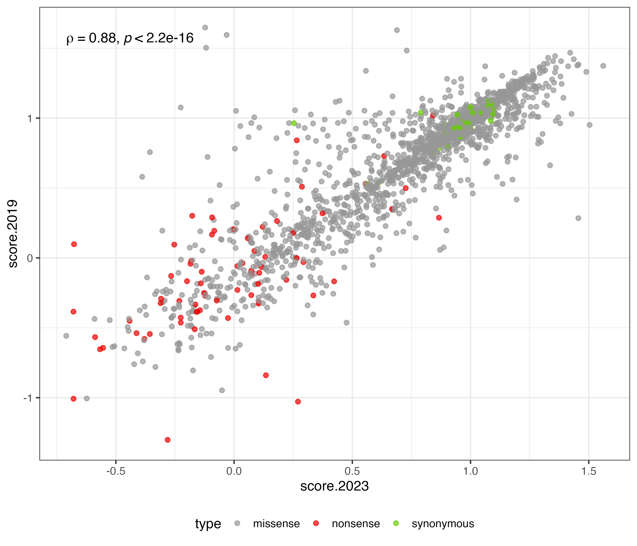
Good Correlation between New & Old Scores

Slide 23
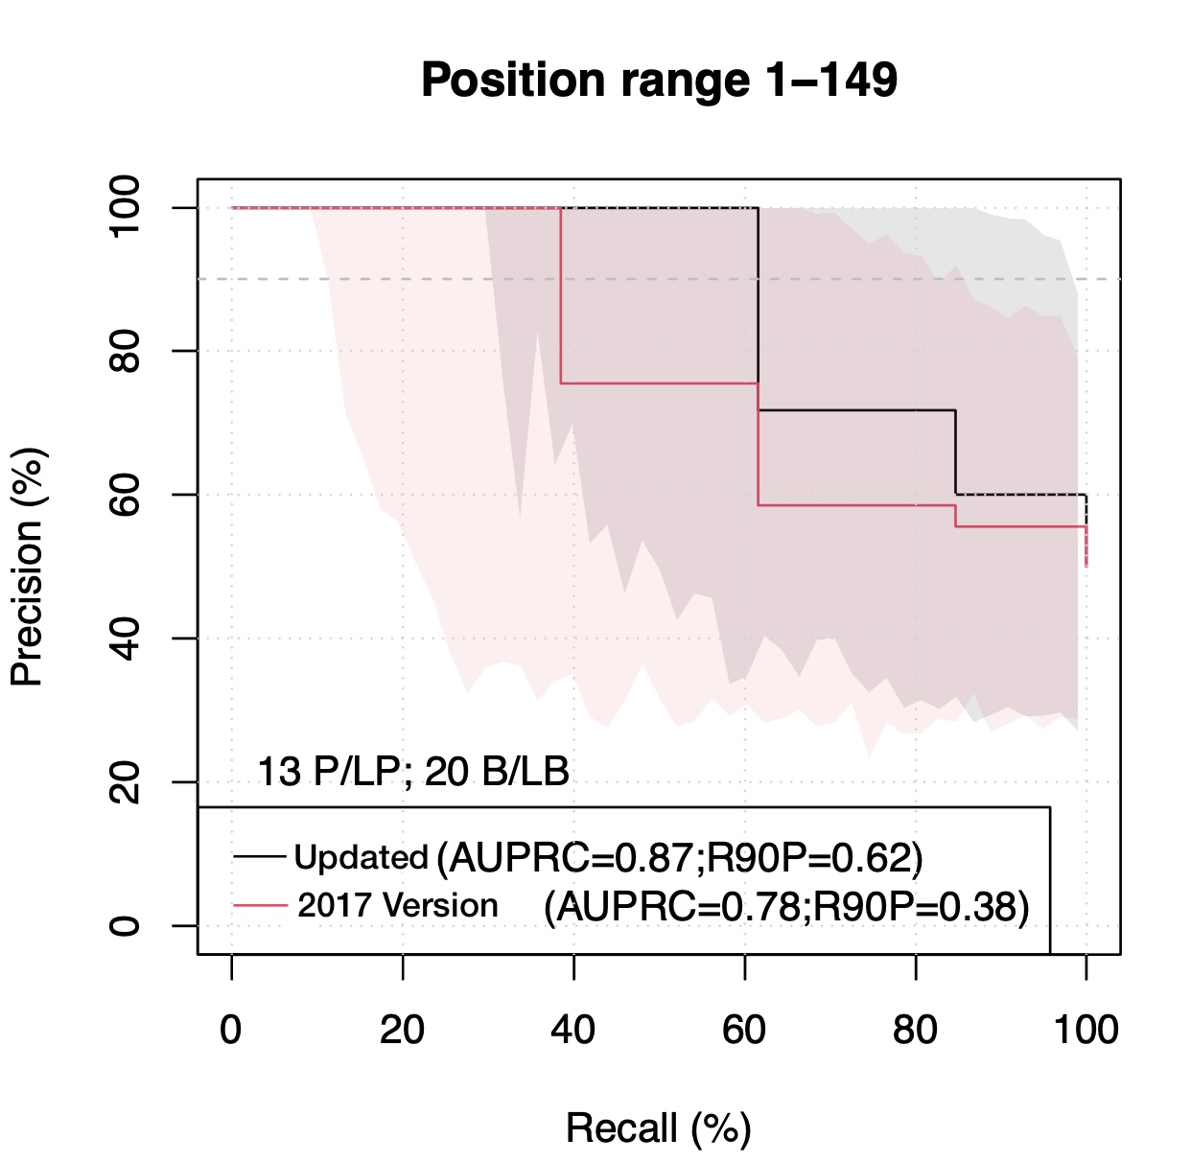
Reference Set: combined reference from GnomAD & ClinVar (CALM1, CALM2, CALM3)
Newer Version Outperformed!
2019
Notes:
Combine calm1 2 3 identical copy

Slide 24
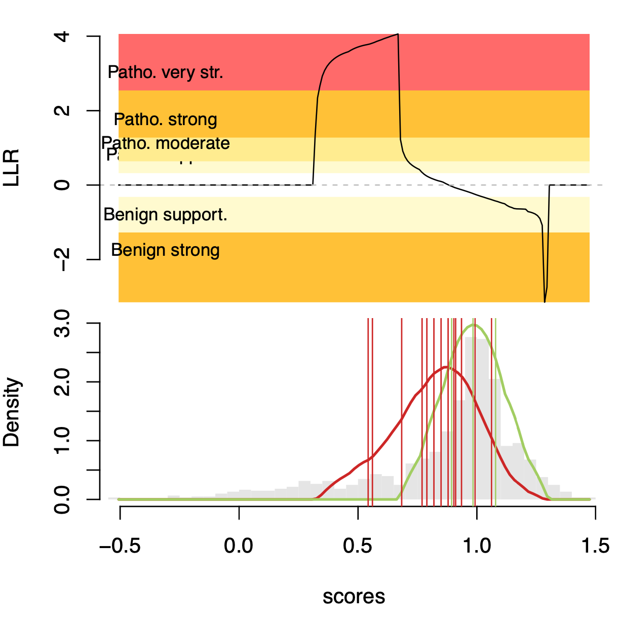
LLR is negative → fitness score range: 0.9 ~ 1.4
(no supported reference data, infer from kernel density estimate)
LLR is positive → fitness score range: 0.3 ~ 0.8
Tendency toward pathogenicity!
Notes:
Benign – not supported ref data – shape infer from kde add grey box

Slide 25
CALM1 Conclusion
The New pipelines performed better than old pipelines
The New pipelines have more accurate Error Estimation

Slide 26
Newer Version of Mavevis Heatmap
SUMO1
CALM1
Good candidate for imputation!
Notes:
Sumo – first 20 disorder region wt 1
Good candidate for imputation

Slide 27
MTHFR in A222V Background
f12AV
f25AV
f100AV
f200AV

Slide 28
MTHFR in A222V Background
f12AV
f25AV
f100AV
f200AV

Slide 29
Discussion & Future goals
SUMO1 – tie
CALM1 – newer pipeline looks better
Compile benchmark reference sets
Re-process more genes later
Write wiki articles for these genes

Slide 30
Thank you!

